Slide 1

Control System Design
Ball on Plate
AbdulAziz Alqatami
Steven Augusto
Jose Luis Leon
Jarod Mica
Alec Mitchell
Department of Mechanical Engineering, Mechatronics and Advanced Manufacturing
CSU, Chico

Slide 2
Overview
Free body diagram
High level architecture
Mathematical model
MatLab code
Results-CoppeliaSim

Slide 3
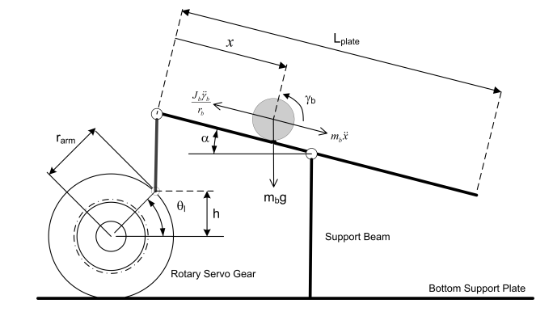
Ball on a Plate-FBD

Slide 4
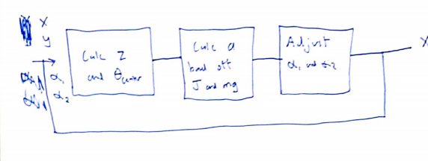
High Level Architecture

Slide 5
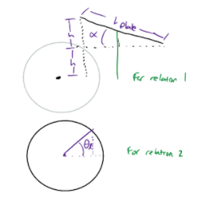
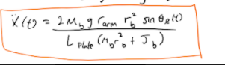
Mathematical Model

Slide 6

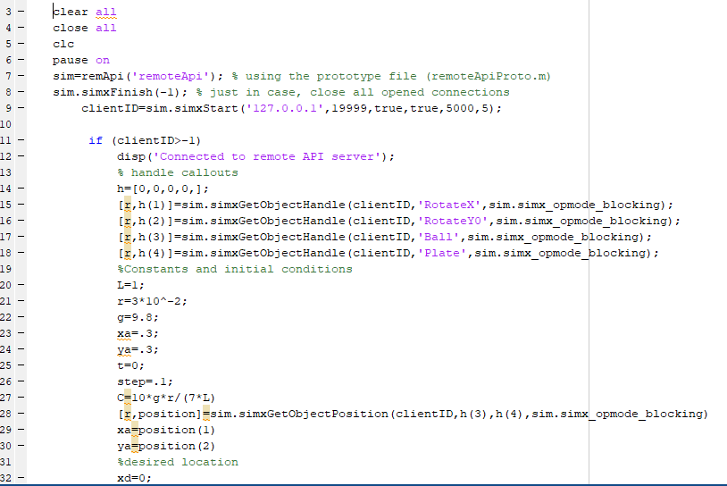
State Space Equation
Matlab Code
March 2020
Control System Design – Week 10
6
6
6
6
6

Slide 7

Results –CoppeliaSim simulation

Slide 8
Thank you
Control System Design
Project
December 2020
Control System Design – Week 16
8
8
8
8
8
8
8

